Slide 1

Using Public-Private Partnerships to
Advance Career and Technical Education
Roger Tadajewski, Executive Director | NC3
(405) 850-9814
roger.tadajewski@nc3.net
Cameron Griffith, Solutions Advisor | Trane
(904) 293-5210
cameron.griffith@trane.com

Slide 2
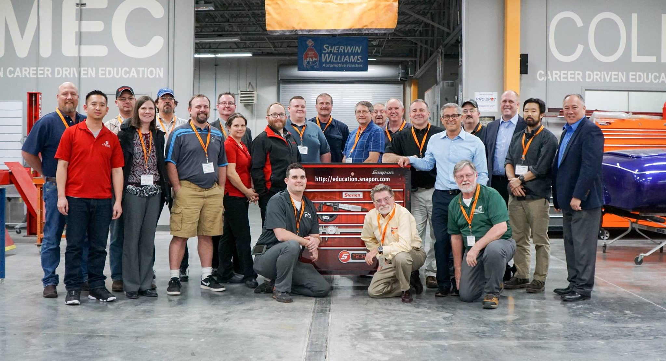
Where Education & Industry Meet
Non-profit network of education providers and corporations committed to training the next-generation of skilled workers to meet industry demands.

Slide 3







National Recognition
Industry Partners in Education
160+
Leadership Schools
700+
Certification Centers
Notes:
KEY TOPIC POINT
Identifying/Developing the Relationships
Emphasizing the Mutual Benefit of Partnership

Slide 4
Ongoing Strong Certification Growth
120,000+ Certifications Earned by the End of 2018

Slide 5
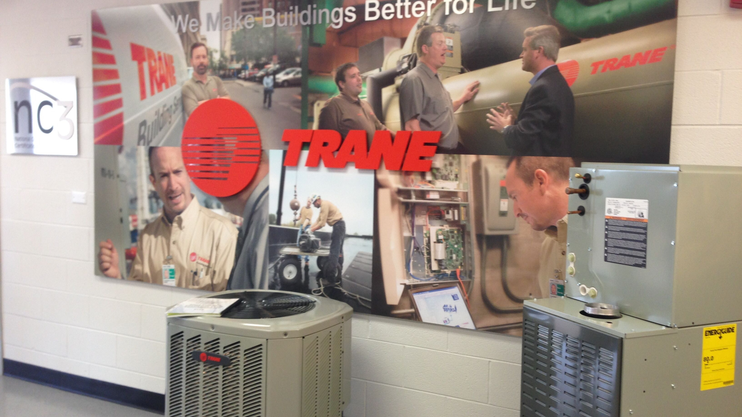
Leadership School Benefits
Vision & Benchmarking
Instructor Training & Development
Turnkey Certification System
Industry Partnership
Events & Activities
Notes:
KEY TOPIC POINT
Making Collaboration Easy

Slide 6
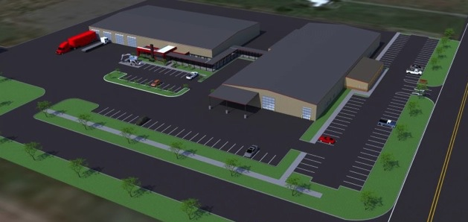
Visioning and
Benchmarking
Inspiration & Ideas
How To
  Facility
  Faculty
  Funding
Notes:
KEY TOPIC POINTS
Building an Effective Implementation Strategy/Timeline
Emphasizing the Mutual Benefit of Partnership
Together with program administrators and industry representatives, NC3 evaluates NC3 members' classrooms, labs, training systems, program goals, and local labor market demands to recommend the ideal educational workspace. The goal is to modernize effective training centers that will attract and produce the highest caliber of student. This may include purging outdated equipment and materials that will not serve a purpose in the redesign and help identify areas of enhancement.

Slide 7
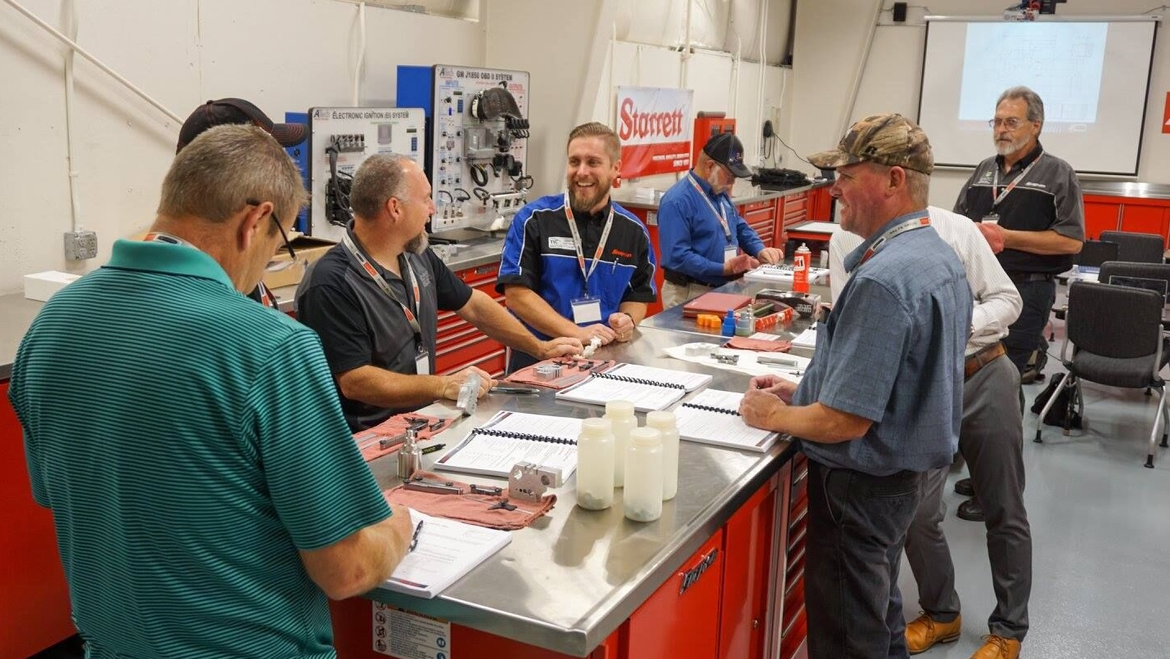
Professional
Development
Hands-on Training Through Train-the-Trainer Events
Become Experts in Latest Industry Certifications
World-Class Training to New and Experienced Instructors
Notes:
KEY TOPIC POINTS
Celebrating and Sharing Successes
Sharing Lessons Learned
Train-the-Trainer events are hands-on professional development opportunities that provide standardized, world-class training to new and experienced instructors. Hosted at NC3 certified member schools and lead by expert instructors, these week-long events offer a classroom experience for instructors to learn and become experts the newest certifications, allowing them to bring their transformed knowledge back to their classrooms.

Slide 8
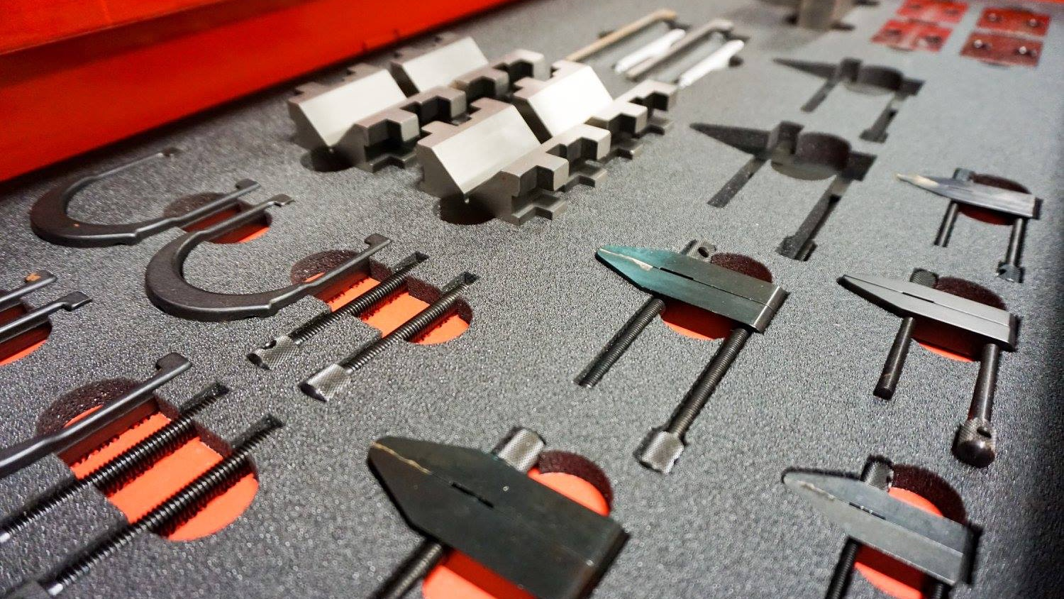
Turnkey Certification
Systems
Curriculum
Lab Sheets
Qualifying Exams
Online Cert Portal and Registry
Instructor Training & Professional Development

Slide 9
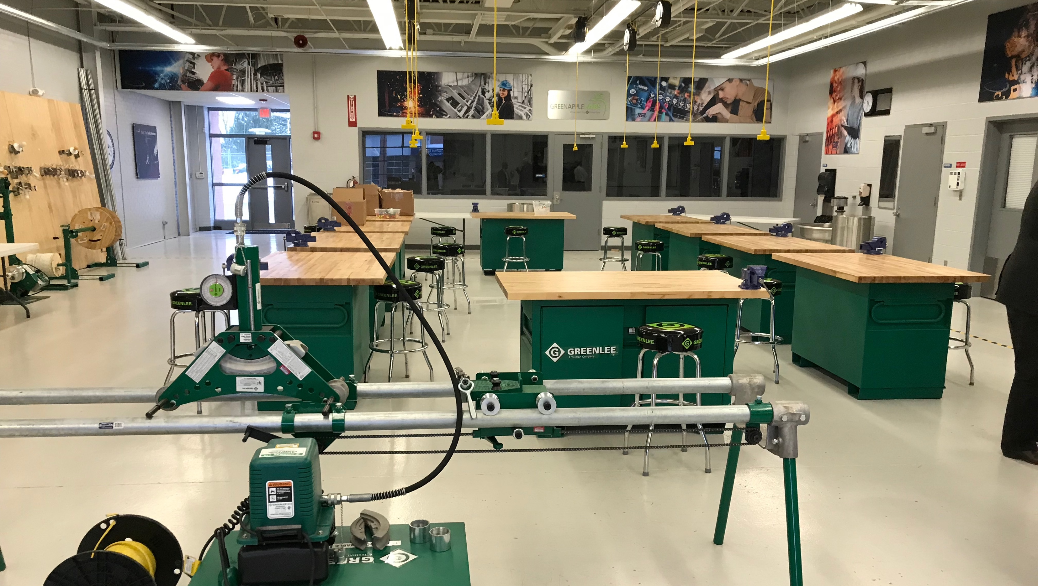
Industry Partnership Opportunities
Achieve Educational Center of Excellence in the Transportation, Construction Trades, Energy, Manufacturing and Aviation sectors
Our Global Industry Partners Work with NC3 Member Schools to Achieve and Support National Center of Excellence
Discounted Equipment/Kit Purchasing
Notes:
KEY TOPIC POINTS
Thinking Outside the Box (Partnerships with Other Industries)
Emphasizing the Mutual Benefit of Partnership

Slide 10
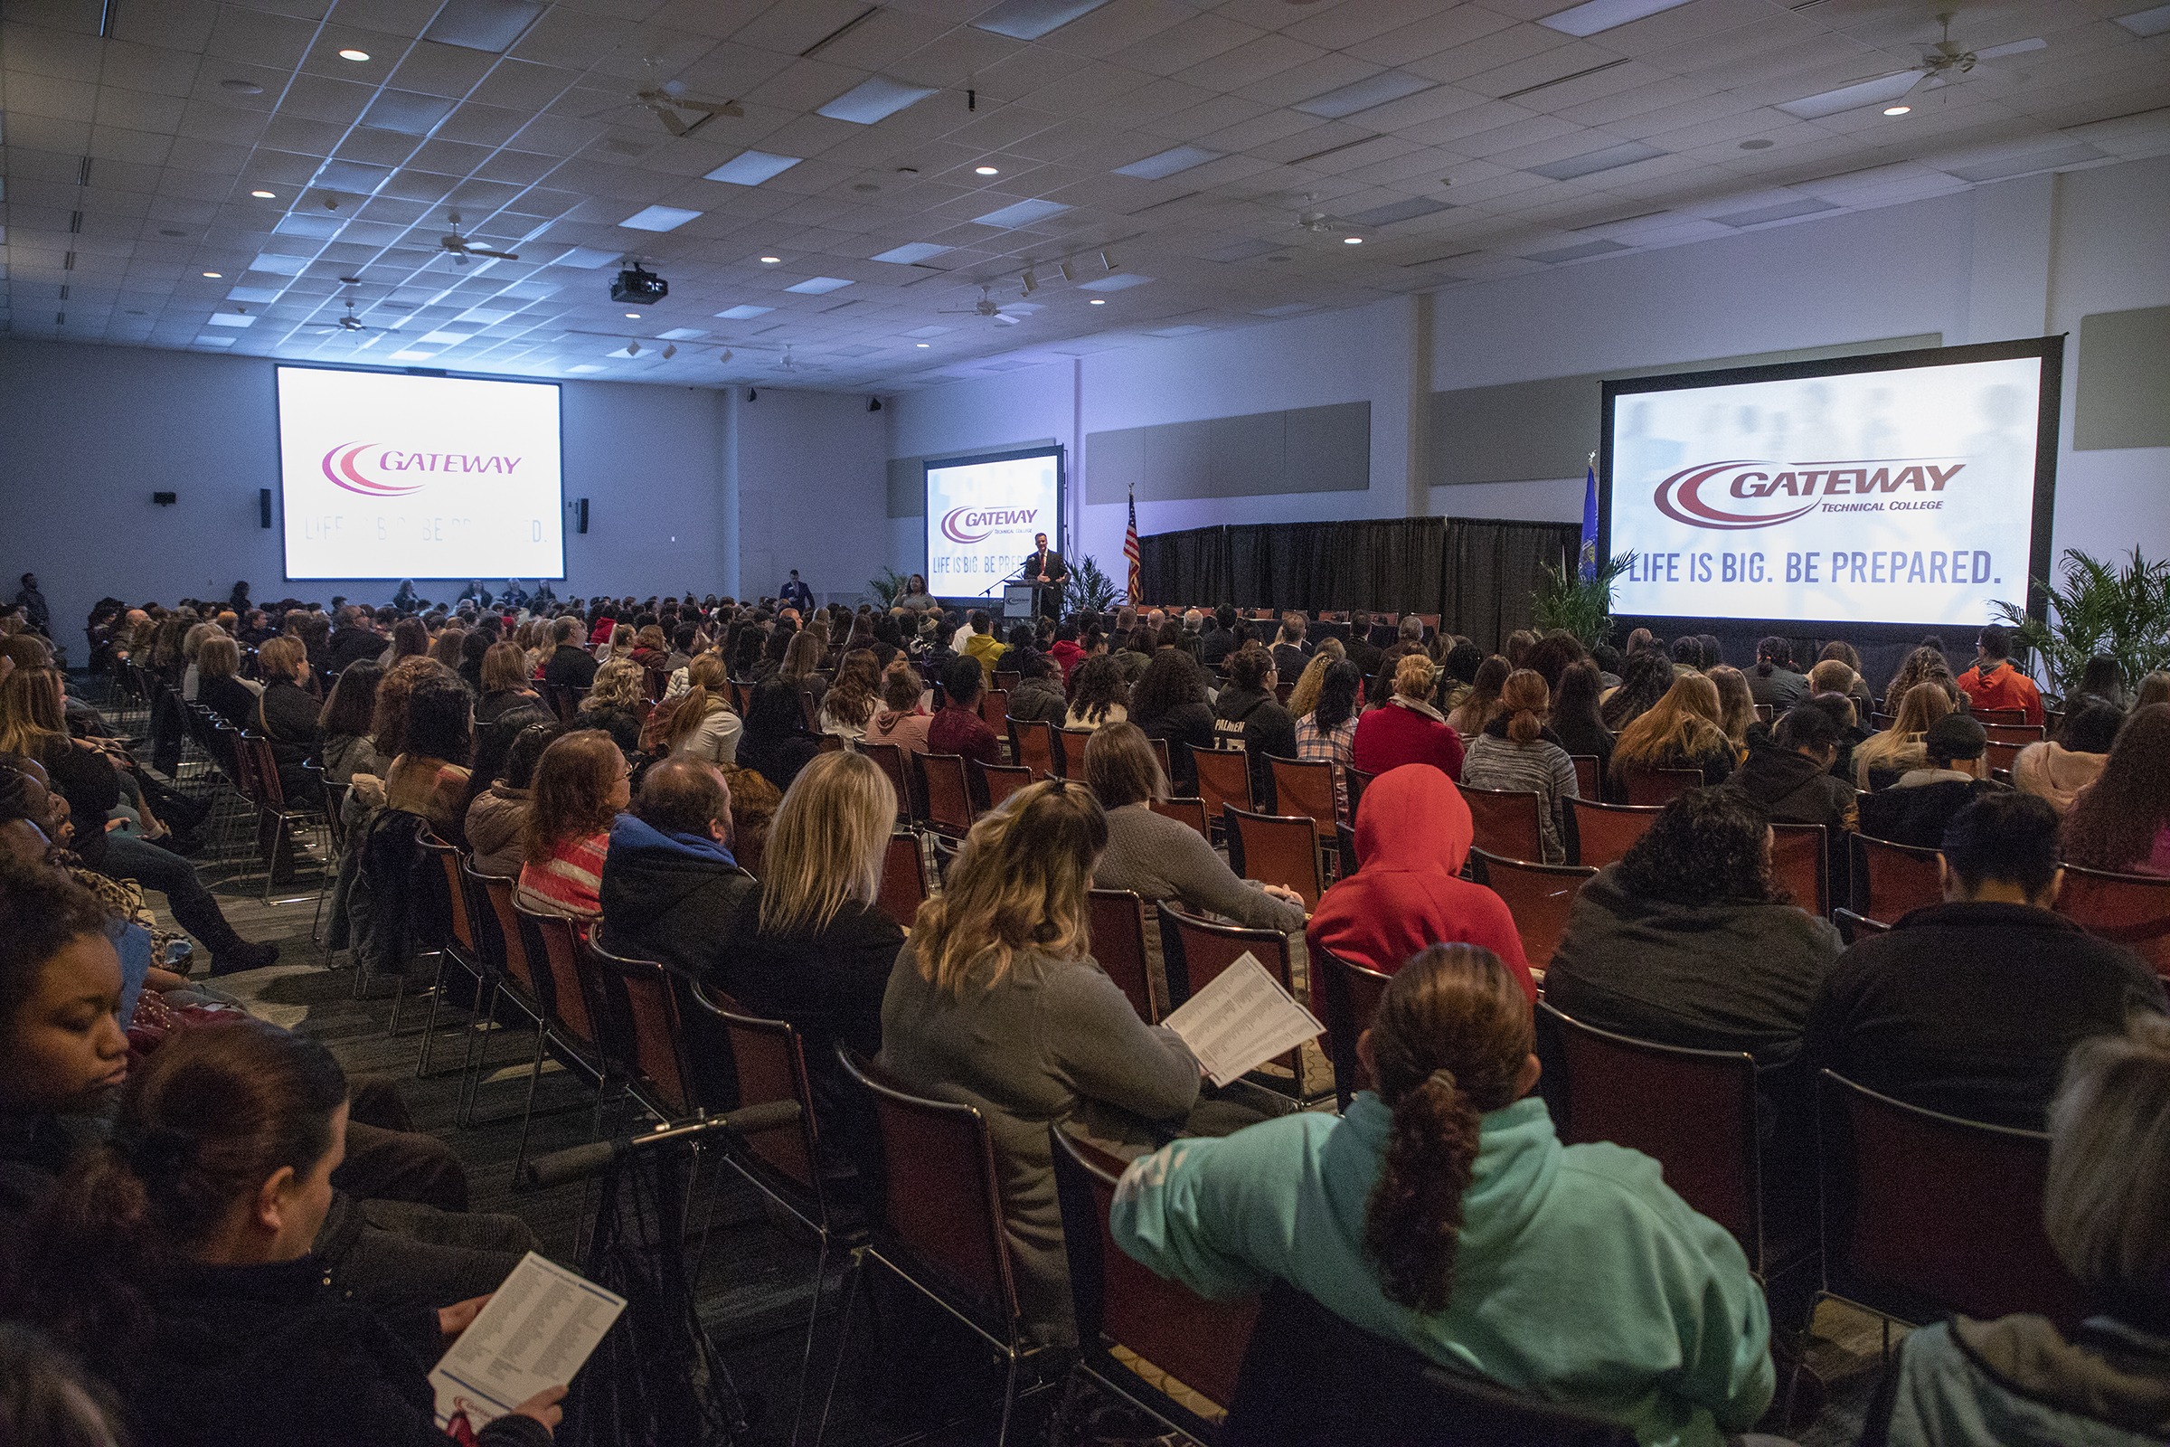
Events & Activities
Exclusive Participation to:
Annual Leadership Summit
National CTE Letter of Intent Signing Day
Notes:
KEY TOPIC POINTS
Being Available and Willing to Participate
Celebrating and Sharing Successes
Sharing Lessons Learned

Slide 11

NC3 CERTIFICATIONS

Slide 12
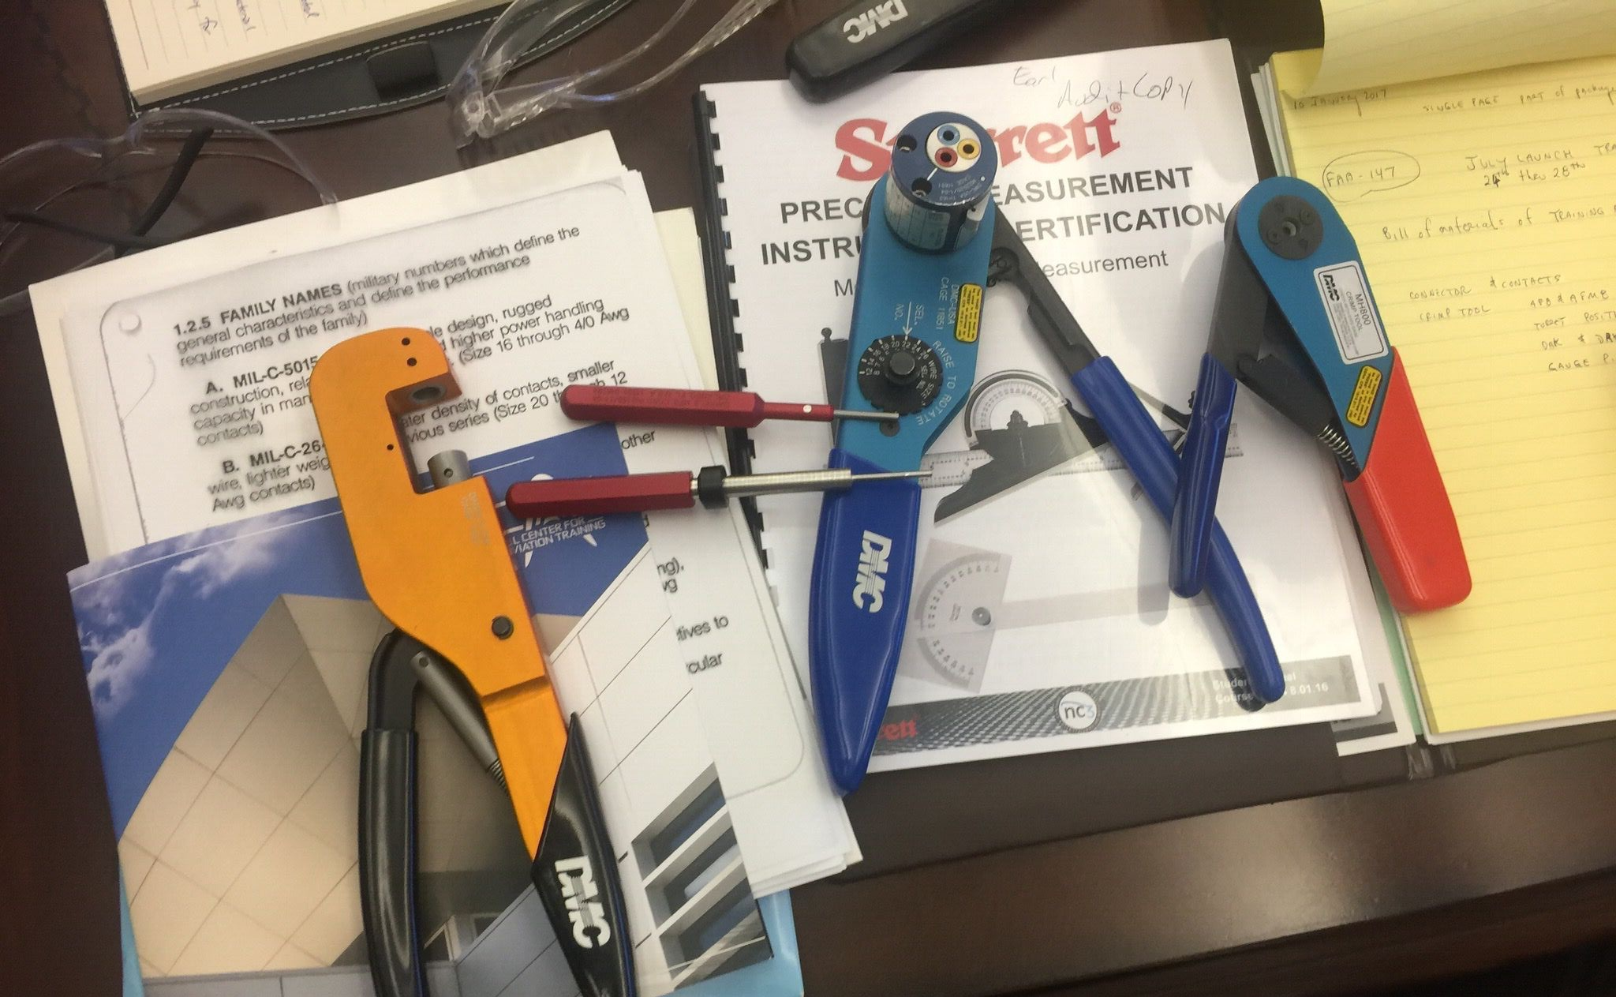
NC3 Certifications
Hands-On Curriculum
Competency-Based
NO COST for Students
Notes:
Making Collaboration Easy

Slide 13
Certifications Across Industries
TRANSPORTATION
ENERGY
AVIATION
MANUFACTURING
BUILDING TRADES
Automotive Diagnostics
Precision Measuring Instruments
Torque Fundamentals
Wheel Service & Alignment
Battery Starting and Charging
Multimeter
Diesel Diagnostics
Off-Road Diesel Technologies
Tools Safety
Residential HVAC Systems
Building Automation Systems
Electrical Installation
Building Performance Instruments
3M VentureClad Tape
Precision Measuring Instruments
Torque Fundamentals
Multimeter
Drop Prevention Systems
Precision Electrical Termination
Structural Sheetmetal Assembly
Precision Measuring Instruments
Torque Fundamentals
Multimeter
Drop Prevention Systems
Telecommunications
Industry 4.0 & Mechatronics
Mechatronics
Hydraulics & Pneumatics
AC/DC Electrical
Introduction to Robotics
Mechanical Systems
Industrial Sensors
PLC - Allen Bradley
Precision Measuring Instruments
Advanced Measuring Instruments
3D Printing
Torque Fundamentals
Multimeter
Telecommunications
Electrical Installation
Industry 4.0 & Mechatronics
Mechatronics
Hydraulics & Pneumatics
AC/DC Electrical
Introduction to Robotics
Mechanical Systems
Industrial Sensors
PLC - Allen Bradley
Residential HVAC Systems
Building Automation Systems
Building Performance Instruments
3M VentureClad Tape
Precision Measuring Instruments
Torque Fundamentals
Multimeter
Drop Prevention Systems
AGRICULTURE
DIGITAL LITERACY
WELDING
Horticulture
Off-Road Diesel Technologies
IC3 Certiport Digital Literacy
3D Printing
SMAW
GMAW
GTAW
FCAW
Safety

Slide 14
| Leadership Schools & Certification Centers
Maine
4
9
Washington
10
Vermont
3
Montana
North Dakota
New Hampshire
6
4
22
New York
Massachusetts
Oregon
Minnesota
37
Rhode Island
11
14
Wisconsin
26
Connecticut
3
South Dakota
48
28
Idaho
3
Michigan
Pennsylvania
15
Wyoming
33
New Jersey
4
Iowa
Maryland
3
11
Ohio
Delaware
Nebraska
22
6
Indiana
West
Virginia
9
Illinois
17
Virginia
Nevada
28
4
24
63
5
Utah
2
Colorado
Kentucky
13
Kansas
Missouri
3
19
16
North Carolina
California
28
Tennessee
56
South Carolina
Oklahoma
25
11
Arkansas
Arizona
New Mexico
3
7
11
Georgia
7
Alabama
15
Mississippi
26
Alaska
3
11
Texas
21
Louisiana
Florida
17
1
Hawaii
Puerto Rico - Caguas
2
10-2019

Slide 15
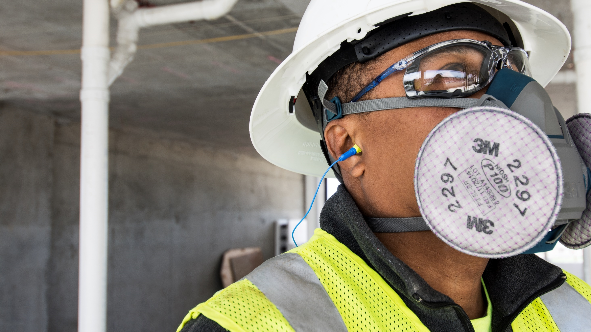

Worker Health and Safety Awareness
• Respiratory Hazards
• Hearing Hazards
• Head, Eye and Face Hazards
NC3 Certificate Program

Slide 16
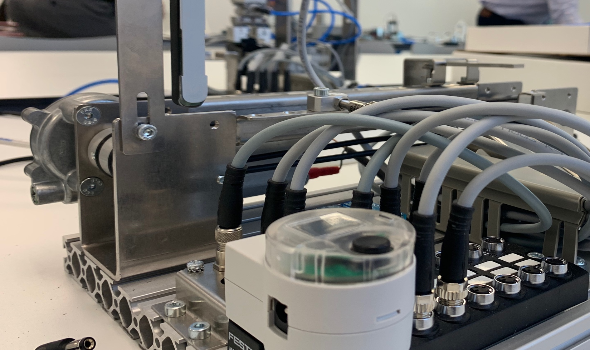
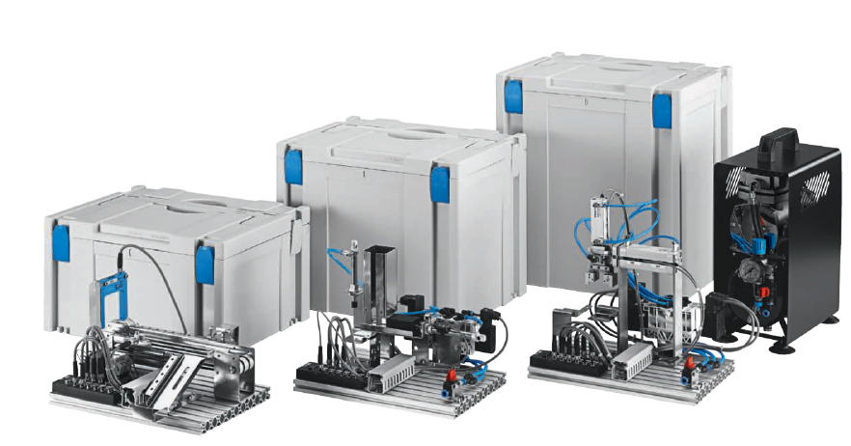

I4.0 Certification Series
For High Schools & Middle Schools
• Introduction to Industrial Automation
• Building Models and Creating Simulations
• Pneumatics, Electrical, Sensors and Controllers
• Using Computers as Tools for Programming
• 3 Stations: Conveyor, Stack Magazine & Handling
• Each Station is Assembled and Ready for Use
Turnkey Curriculum & Professional Development
Partners:

Slide 17

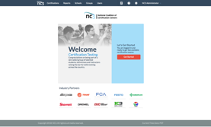


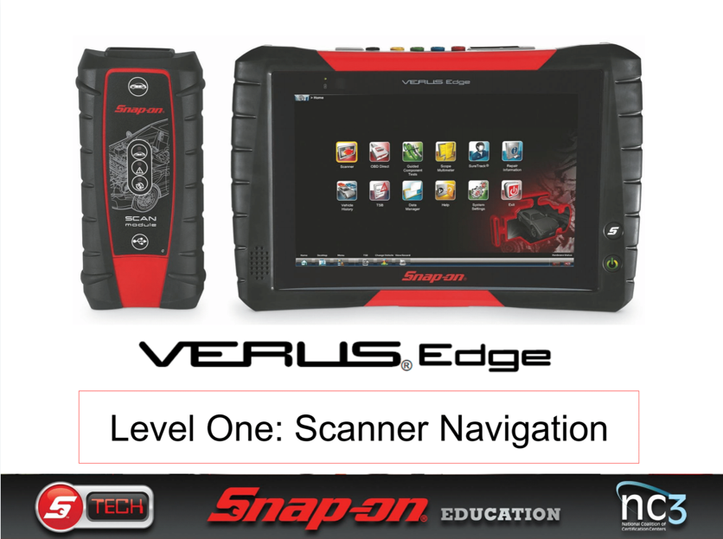
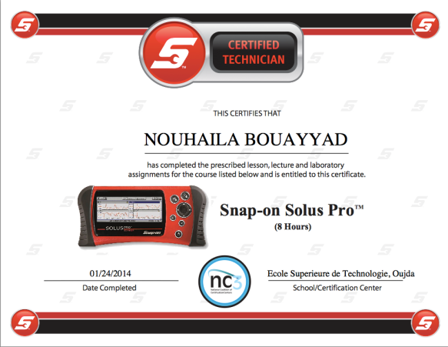
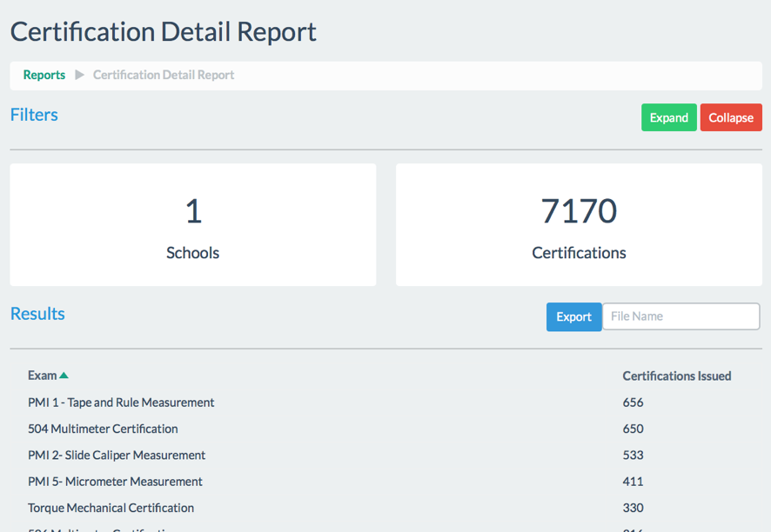
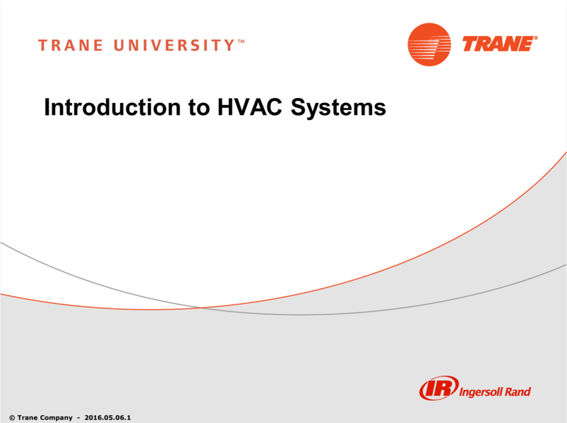
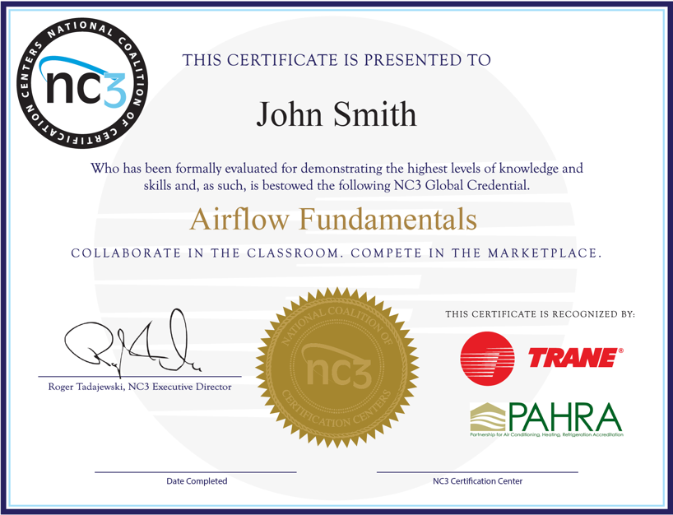

One Site. Complete Solution.
Instructor Resources
Student Certifications
Insights
Curriculum Access and Student Activation
Exam Site and
Certification Repository
Individualized Performance Reports

Slide 18
Building World Class Partnerships
…and Producing a Sustainable, Highly-Skilled Worfkforce for Tomorrow.
Notes:
NC3 certifications are driven by the economy needs and industry standards. NC3 has partnered with world-renowned, credible industry brands to provide insight into what are the biggest needs in workforce development and technical skill. By partnering with these leaders, students can access the workforce with up-to-date industry knowledge that can be applied to any brand or industry.

Slide 19
Trane NC3 Program Overview
Cameron Griffith, Solutions Advisor | Trane
(904) 293-5210
cameron.griffith@trane.com
Notes:
Roger

Slide 20
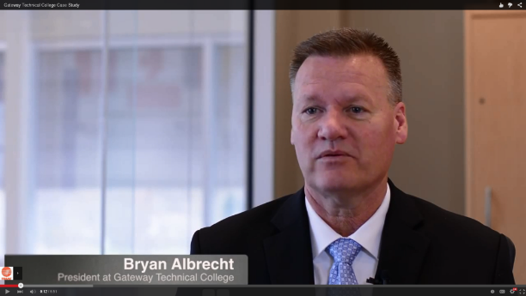
The Power of Partnership
‘As college president, I now know how a relationship with a business corporation can benefit the community, can benefit direction of board of trustees, can improve program experience for faculty and ultimately increase the success rate of our students’
Bryan Albrecht, President of Gateway Technical College
Impacting communities nationwide with workforce development by helping technical educators train students in needed skills.
Notes:
Roger

Slide 21
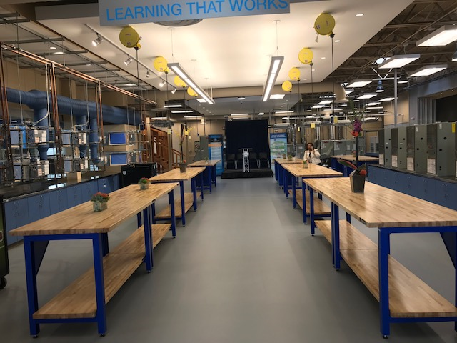
Why Trane is Partnering with NC3
Trane sponsors the nonprofit National Coalition of Certifications Centers (NC3) to:
Have a positive impact on career and technical education, and workforce development, in the HVAC and energy efficiency industry.
The program works because all stakeholders benefit:
- Technical Educators
- Local Communities
- Industry, including Trane
This work is important and makes a positive difference to many people on many levels.
Notes:
Cam Starts here!
NC3 is the main course.
Here is what Trane does in NC3. Why we partner. What we provide. Labs. Why important.
Trane labs – what they have in common. Make it easy for schools to build the footprint and rebuild a program
Cameron is the guy and POC for any NC3 program, especially Trane. AFC member to connect to NC3.
Execute – national program executed locally. Corporate resources applied. Doing it nationally. Execute locally.

Slide 22

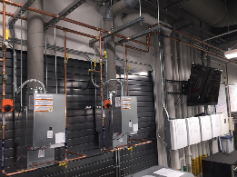
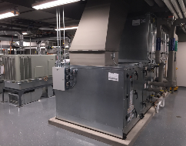
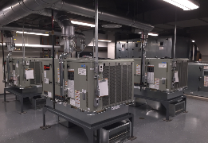
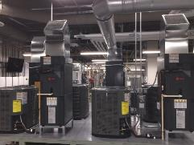
How Technical Educators Benefit
Trane’s NC3 program delivers the following:
  A trusted industry partner
  Industry relevant curriculum, certifications
  Instructor training, professional development
  Access to a broader network of educators
  Proven/low risk labs, and a sustainable model
  Other collaborations with Trane, like career day
Western Technical College in La Crosse, WI
Helping technical educators attract, train, and place students.

Slide 23
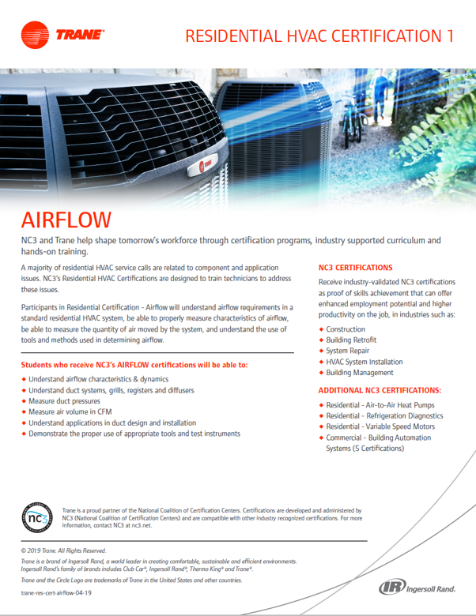
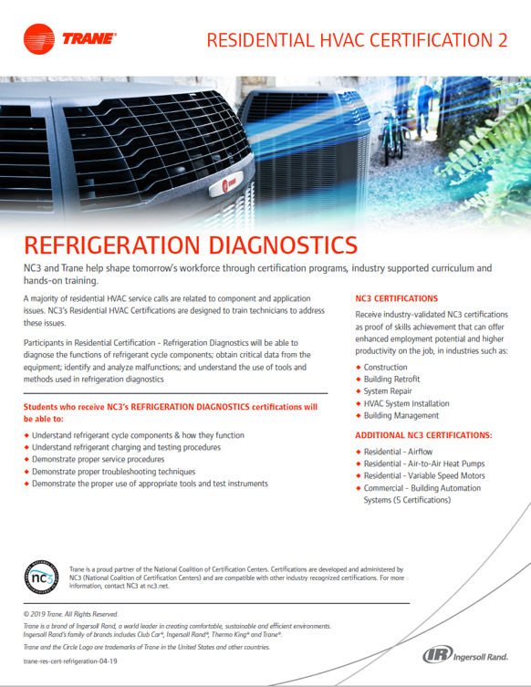


Trane Residential
Trane NC3 Residential HVAC Certifications
  Strengthen students’ preparation in key areas
  Utilize the hands-on approach that is an NC3 hallmark
  Are taught in well-equipped labs
  Increase the chances for a student to succeed as an employee
Trane NC3 Residential HVAC Certifications currently available:
  Airflow
  Refrigeration Diagnostics
  Variable Speed Motors
  Air-to-Air Heat Pumps
Trane NC3 Residential HVAC certifications provide essential fundamentals.

Slide 24
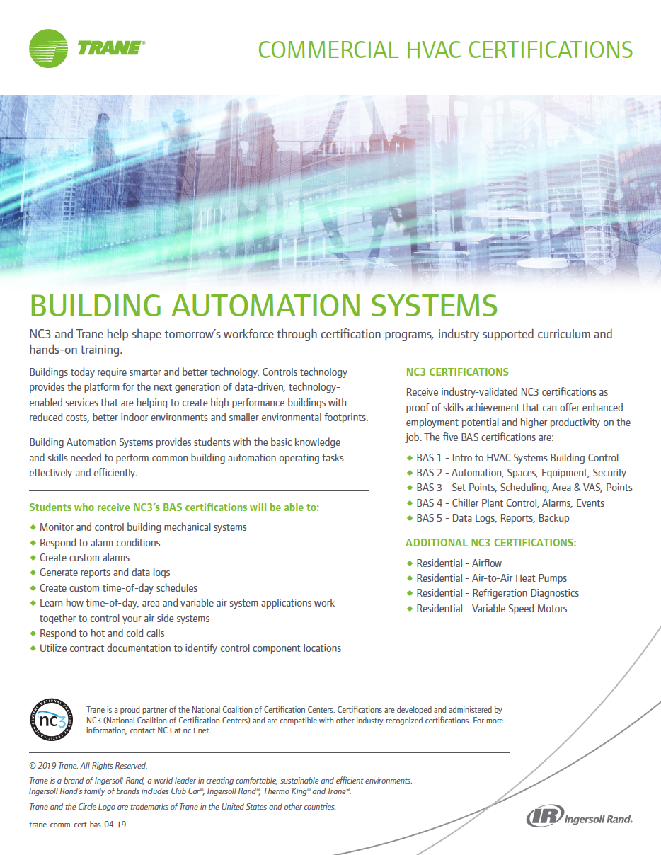
Trane Commercial
Trane NC3 BAS Certifications
Give technical school students exceptional hands-on experience in
state-of-the-art learning environments
Provide access to the most current, relevant curriculum available
Help address skilled workforce needs regionally and nationally
Five Trane NC3 industry-recognized BAS certifications:
  BAS 1 - Intro to HVAC Systems, Building Control
  BAS 2 - Automation, Spaces, Equipment, Security
  BAS 3 - Set Points, Scheduling, Area & VAS, Points
  BAS 4 - Chiller Plant Control, Alarms, Events
  BAS 5 - Data Logs, Reports, Backup
Trane NC3 Commercial HVAC certifications train students in controls and systems.

Slide 25
| NC3 Trane Learning Labs
NC3 Trane BAS
Centers of Excellence
Alaska
14
NC3 Trane Residential
HVAC Labs
Hawaii
19

Slide 26
Employment Opportunities in HVAC and Energy Fields
United
States
Florida
32,670
2016 Employment
332,900
2016 Employment
41,410
2026 Employment
381,700
2026 Employment
27%
Percent Change
15%
Percent Change
4,380
Annual Projected
Job Openings
38,700
Annual Projected
Job Openings

Slide 27
Trane NC3 Case Studies
Notes:
Case studies – challenges – solution and results
How incorporated into NC3 network
Frame it “as a story”

Slide 28
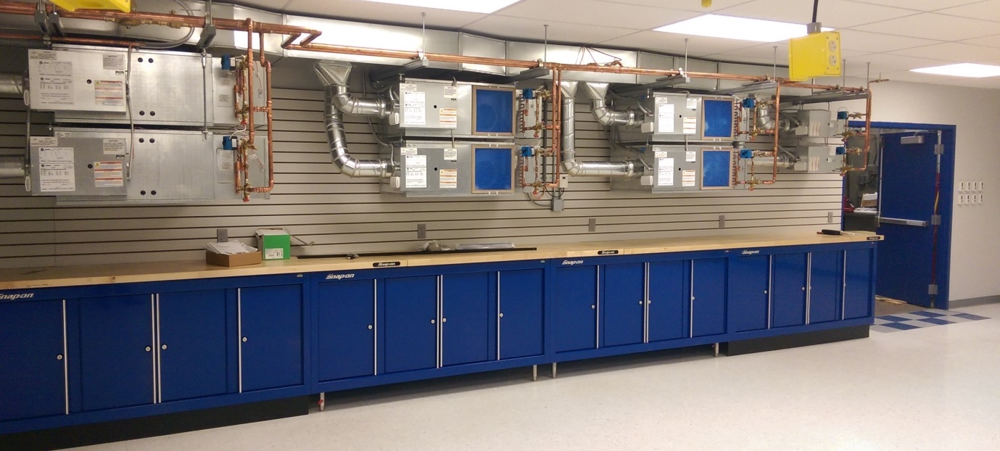
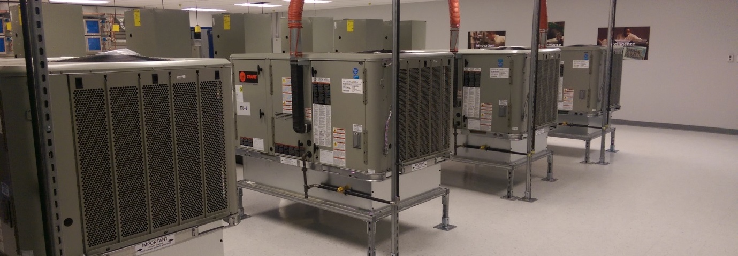
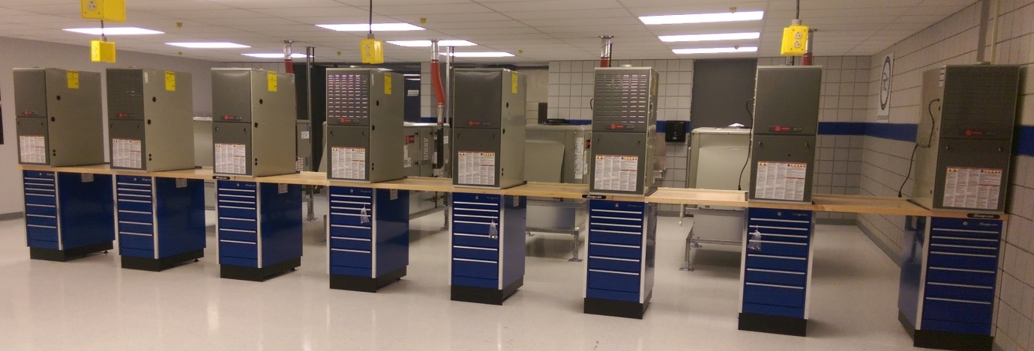
Trane NC3 Case Study:
Trane NC3 Case Study:
Challenge
Outdated Equipment & Facility
Recruiting New Students
Need New Curriculum & Technologies to Meet Industry Demands
Solution
Improve Facility & Training Labs
Enhanced Curriculum & Hands-on Learning
Provide Training for Trainers
Results
State-of-the-Art Facility
Industry-Relevant Curriculum
Waiting List for HVAC Program
Well-Trained Instructors
Notes:
Great places to ‘teach’ in as well. Retention

Slide 29
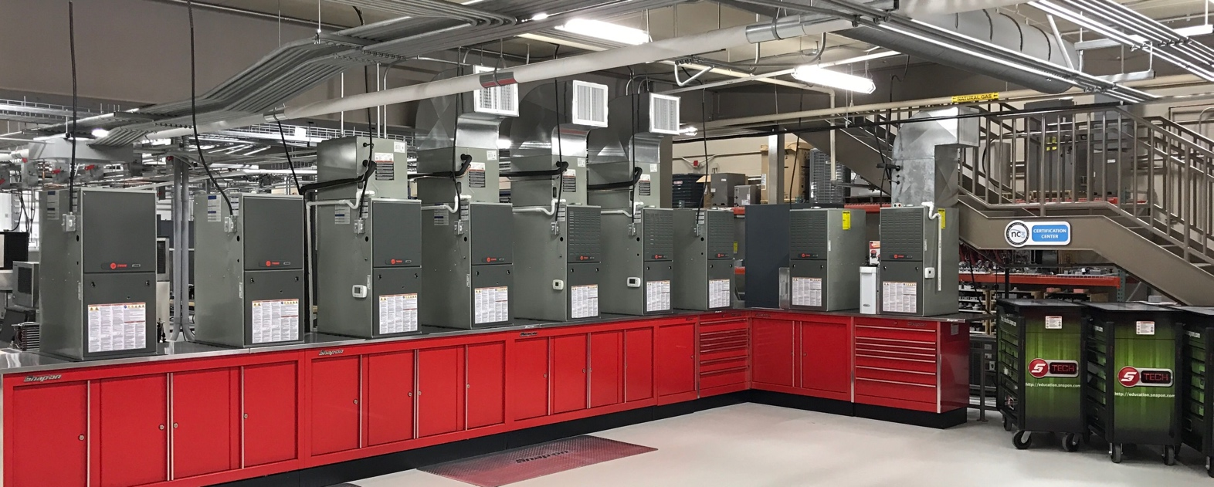
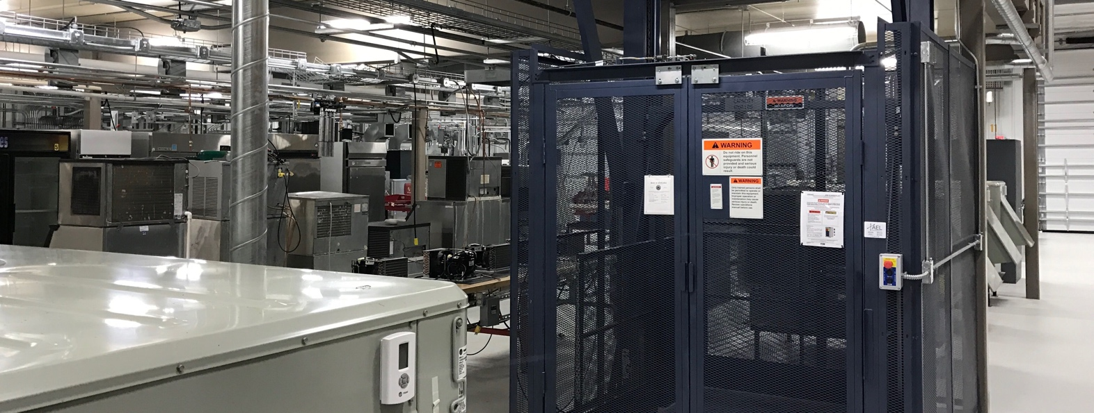
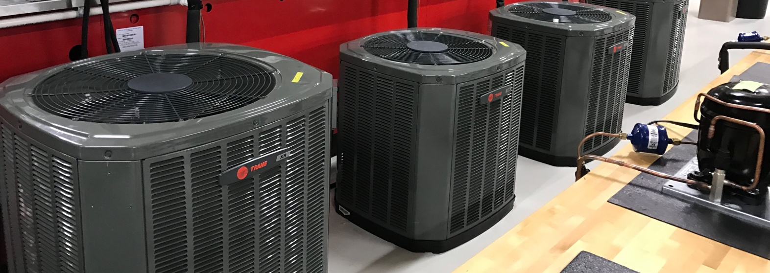
Trane NC3 Case Study:
Trane NC3 Case Study:
Challenge
Outdated Equipment & Facility
Recruiting New Students
Need New Curriculum & Technologies to Meet Industry Demands
Residential HVAC Only
Solution
Improve Facility & Training Labs
Enhanced Curriculum & Hands-on Learning
Expand Program to Residential & Commercial
Provide Training for Trainers
Results
State-of-the-Art Facility
Industry-Relevant Curriculum
Waiting List for HVAC Program
Well-Trained Instructors
Notes:
Program proponents. Great booster for the program

Slide 30
Trane NC3 Centers of Excellence
Notes:
We have a few more…not just 2. All have slightly different look. But meet the core requirement
Cameron is your guy and POC for any NC3 program, especially Trane. AFC member to connect to NC3.
Execute – national program executed locally. Corporate resources applied. Doing it nationally. Execute locally.
Outstanding learning environments

Slide 31
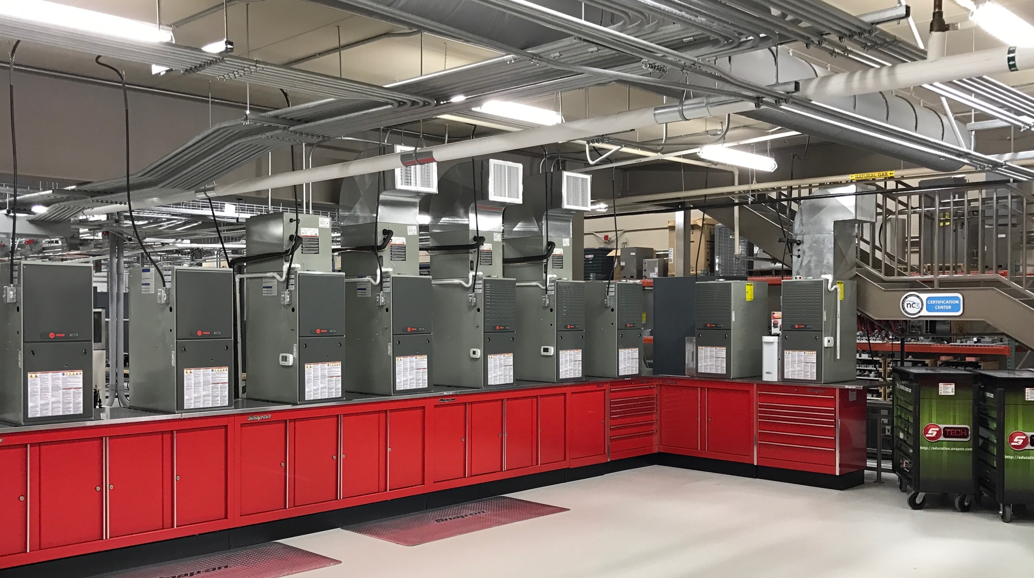
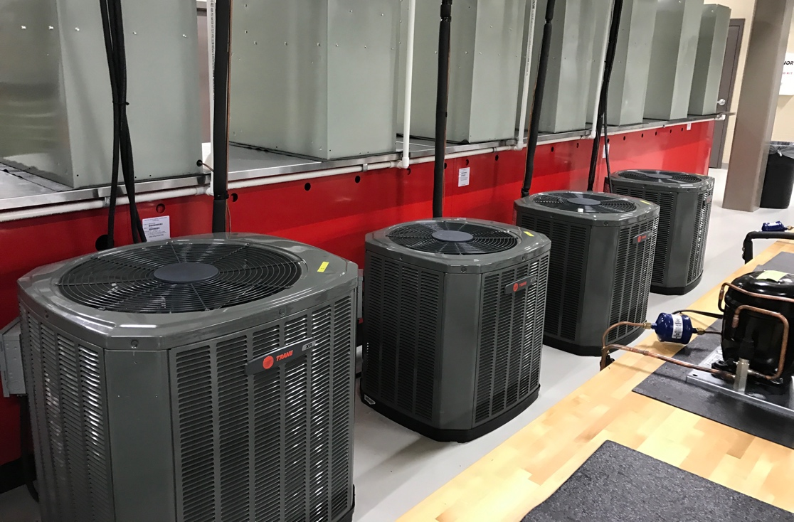
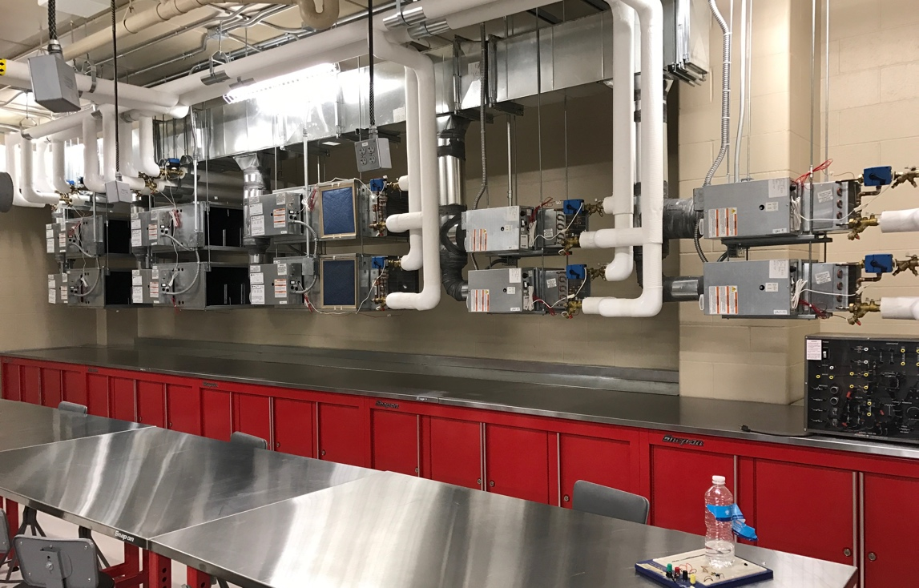

Energy Center
Partner:
Notes:
Trane and NC3 work together to build a standard, turnkey lab across the board. Professional look and feel. Standardized but design-able. Fit to different spaces. Work with each school. Standardized program but fit and finish to match the school.

Slide 32
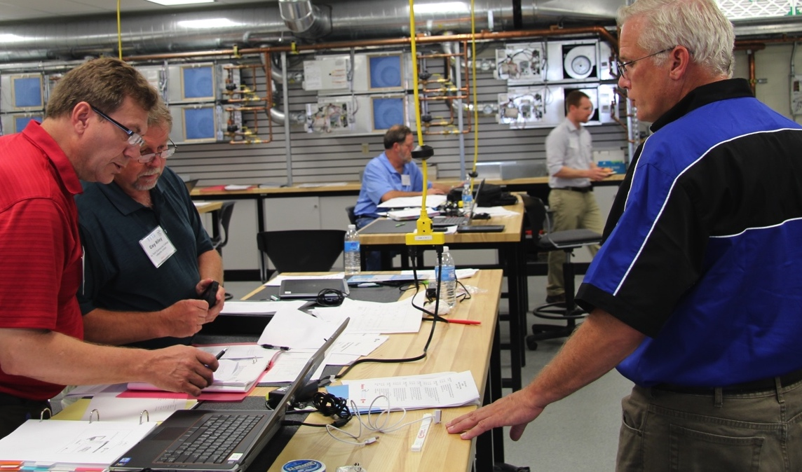
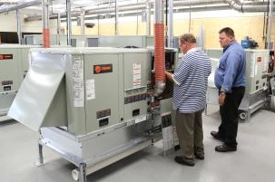
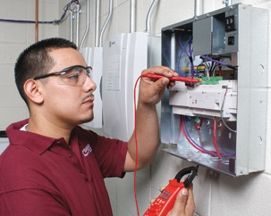
Trane Lab
Partner:

Slide 33
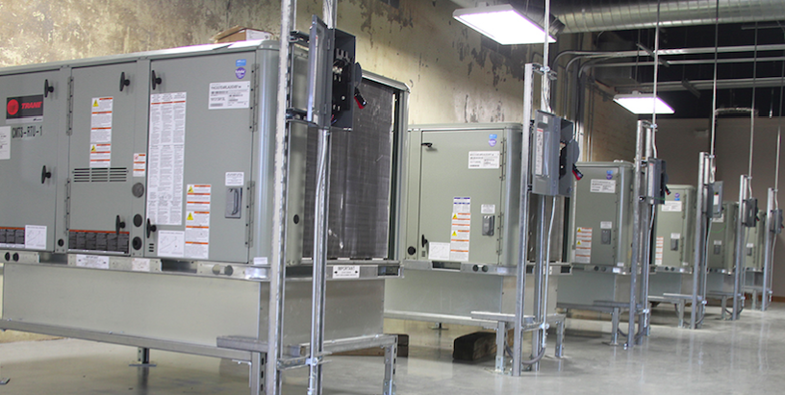

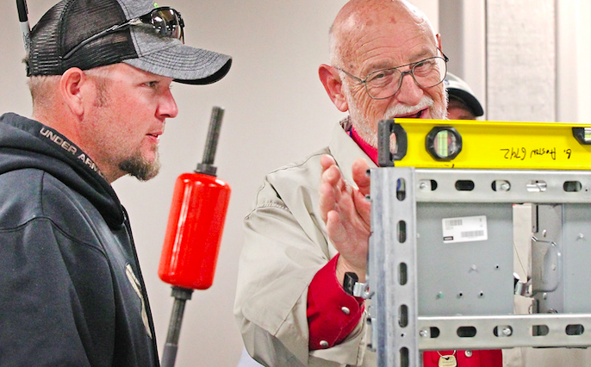
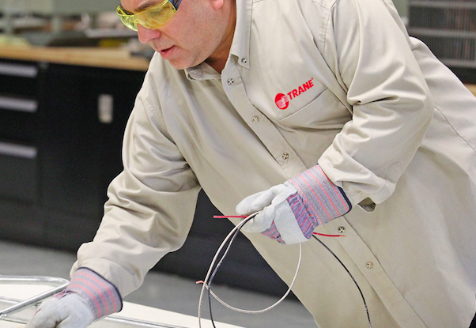
Trane Lab
Partner:

Slide 34
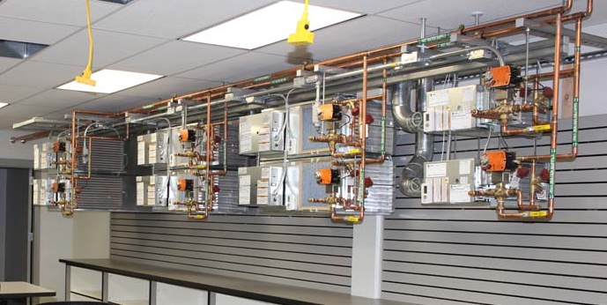
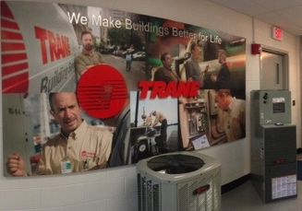
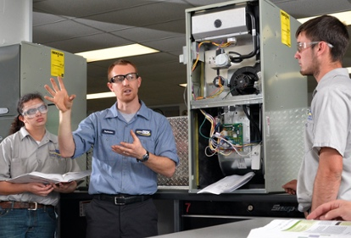
Midwest Training Center
Partner:

Slide 35
CENTERS OF EXCELLENCE
NC3 BENCHMARK SCHOOLS – SUCCESS IN PARTNERSHIP

Slide 36
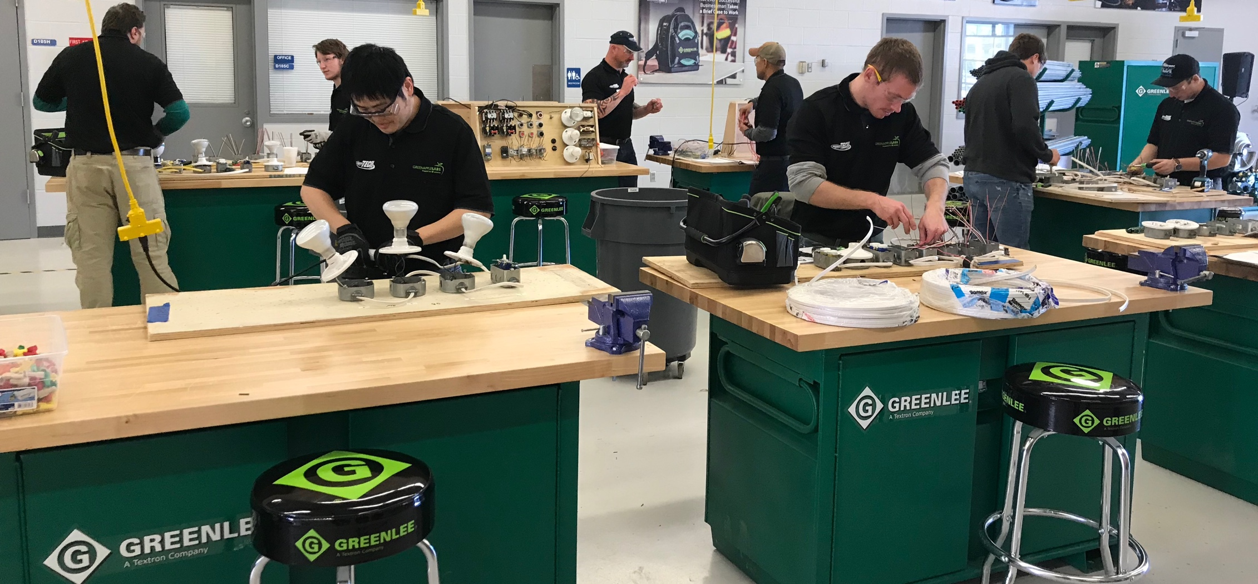

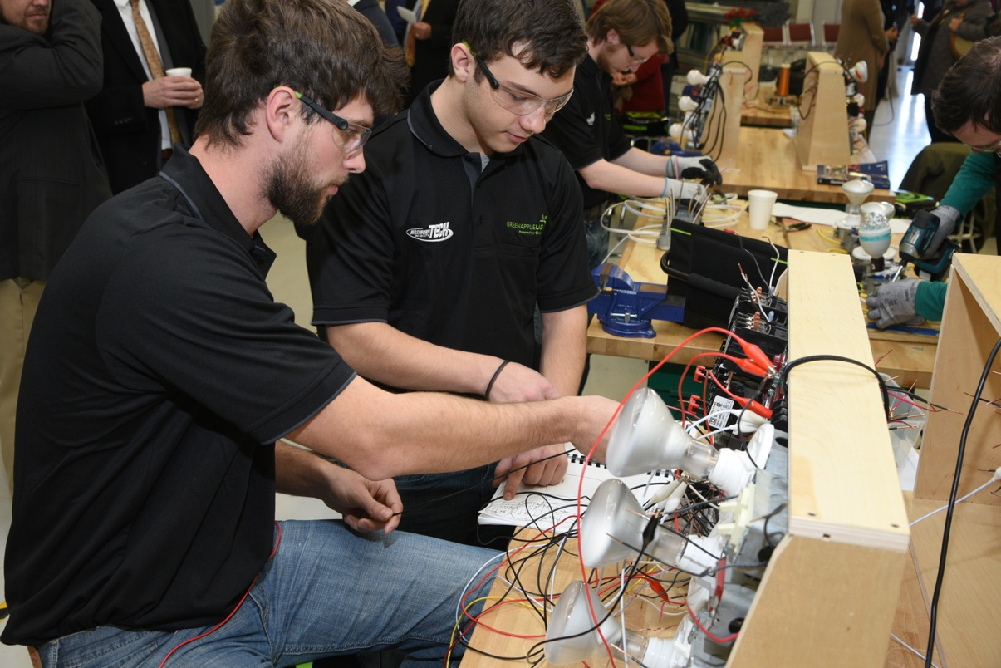
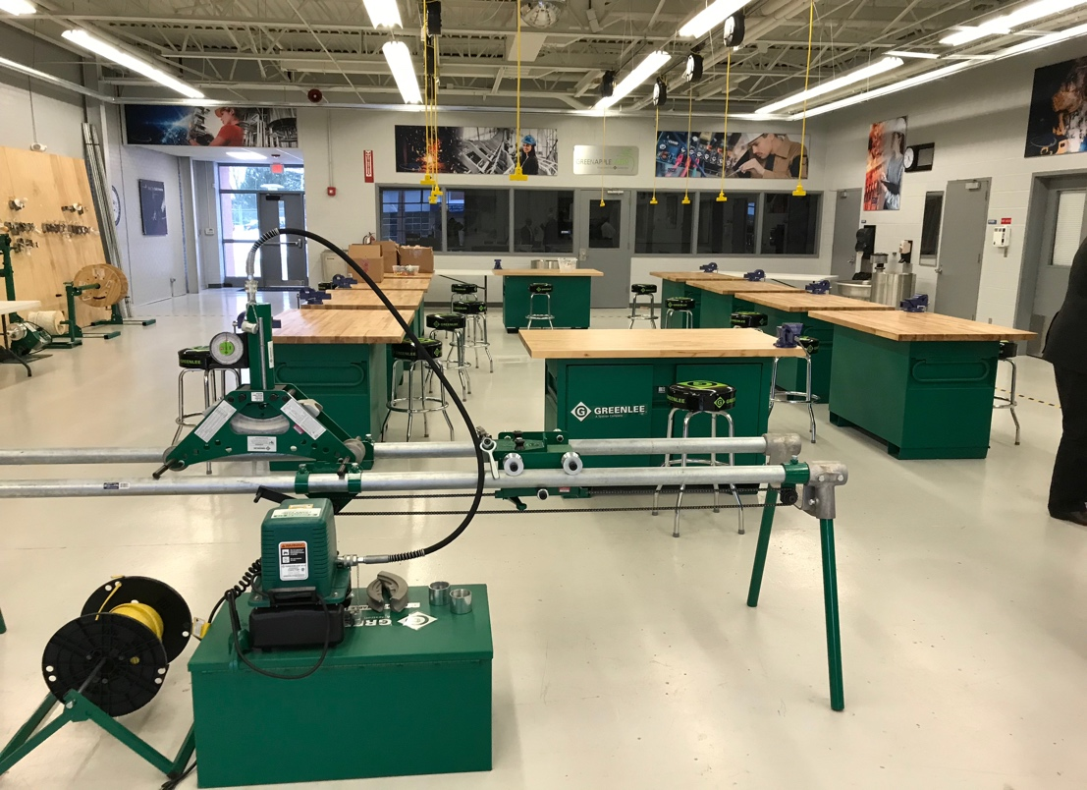
Electrical Lab
Partner:

Slide 37
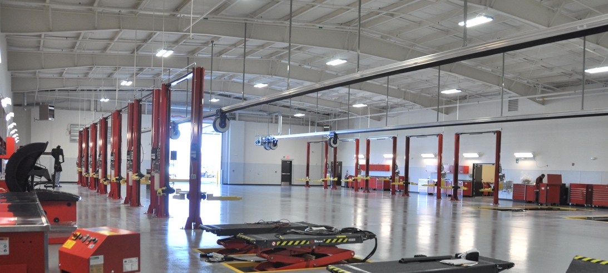
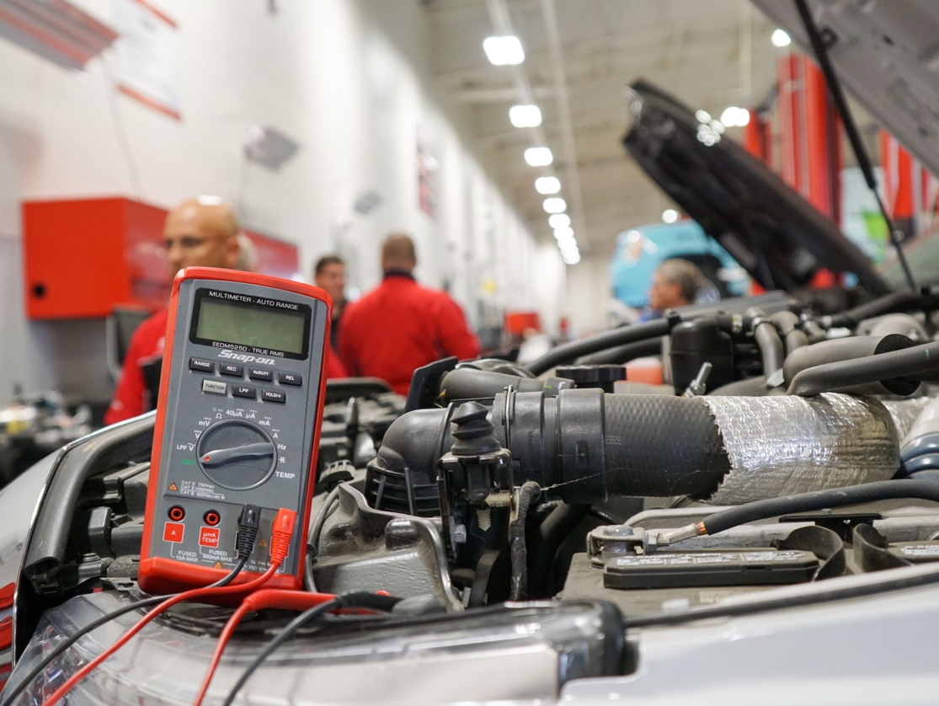
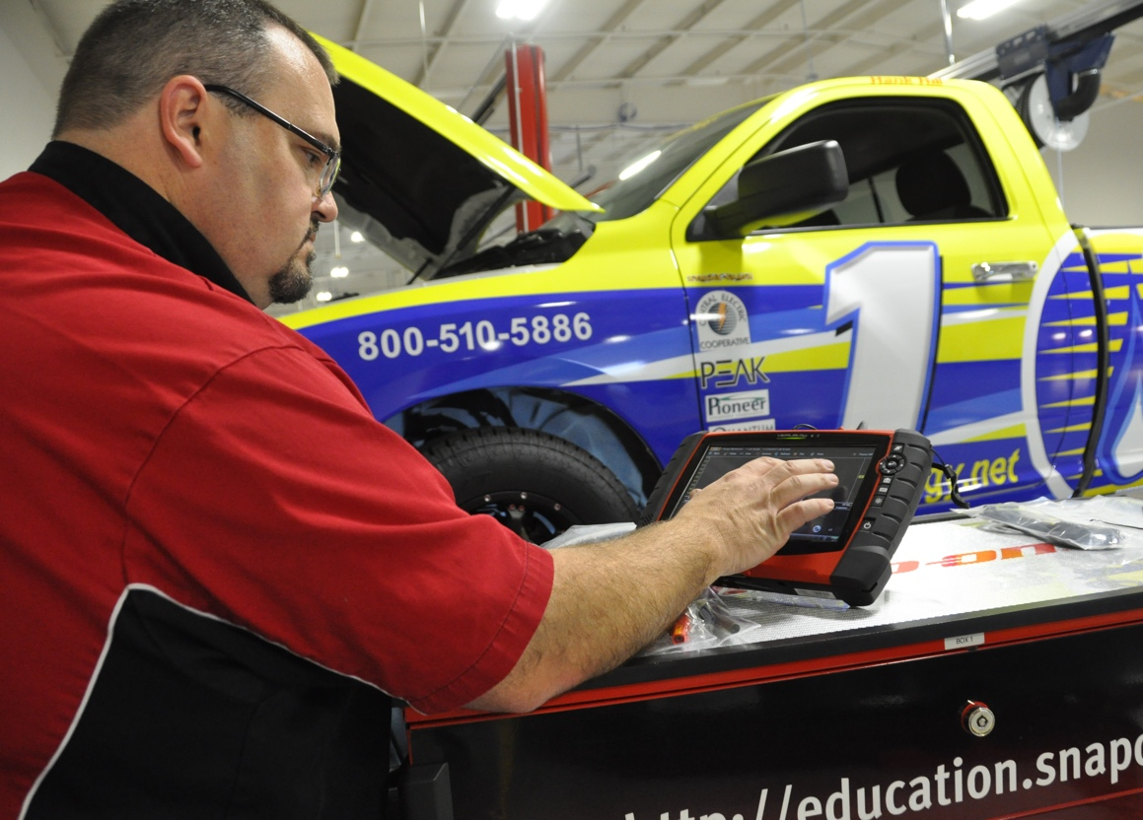

Automotive Program
Partner:

Slide 38




Industry 4.0 Lab
Partner:

Slide 39




National Center for Aviation Training
Partners:

Slide 40





Diesel Program
Partner:

Slide 41



Construction Trades
Partner:

Slide 42




Welding Program
Partner:
Notes:
Add Gateway Image
Wallace State

Slide 43




FabLab Program
Partners:
Notes:
School images

Slide 44
Using Public-Private Partnerships to
Advance Career and Technical Education
Roger Tadajewski, Executive Director | NC3
(405) 850-9814
roger.tadajewski@nc3.net
Cameron Griffith, Solutions Advisor | Trane
(904) 293-5210
cameron.griffith@trane.com

